Slide 1
COmplex Data EXplorer
v3.1
Know
Thy
Data
JPL Confidential
Proposal-Sensitive Material
CODEX
Dr. Lukas Mandrake

Slide 2
COmplex Data EXplorer
Know
Thy
Data
CODEX

Slide 3
Cross-Industry Standard Process for Data Mining
Dr. Lukas Mandrake
CODEX facilitates:
Data Understanding
Data Preparation
User Need
Existing framework CRISP-DM
“De-Facto Data Mining Methodology”¹
1 - Marbán, Mariscal, Segovia (2009); A Data Mining & Knowledge Discovery Process Model.
ISBN 978-3-902613-53-0, pp. 438-453, February 2009, I-Tech, Vienna, Austria. Wikipedia

Slide 4
What’s the Goal?
Dr. Lukas Mandrake
Mission Engineering Data
Thermal Vac
Calibration
Ops Data
System Health
Data Quality
Pipeline Statistics
Science Data
Time and Space Grids
High Dimensionality
Multiple Sources
GIS pain
Support Later Analysis
Inspect
Understand populations
Relate Columns
Build intuition
Filter
Export findings
Some app features are required but common and some are revolutionary.

Slide 5
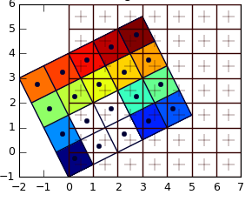
Data In and Out
Dr. Lukas Mandrake
Human Readable
CSV, TXT, KML, XML
Mission-Oriented
HDF-EOS5
Multiple files OK
Facilitate alignment
Output guidance: file / memory size
Scientific/Binary
HDF
NetCDF
DAP2
SeaBASS
GeoTIFF
Link different files
(observation ID)
Co-Registration
Co-Location
Re-Gridding
Proprietary
Matlab
IDL
Excel XLS

Slide 6
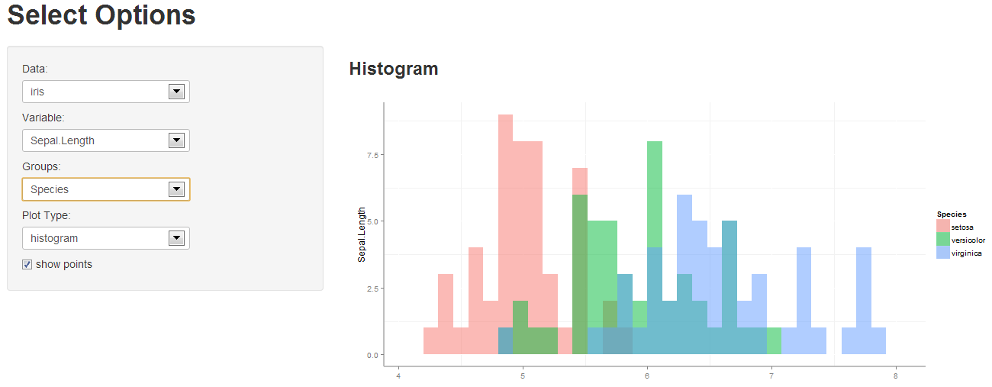
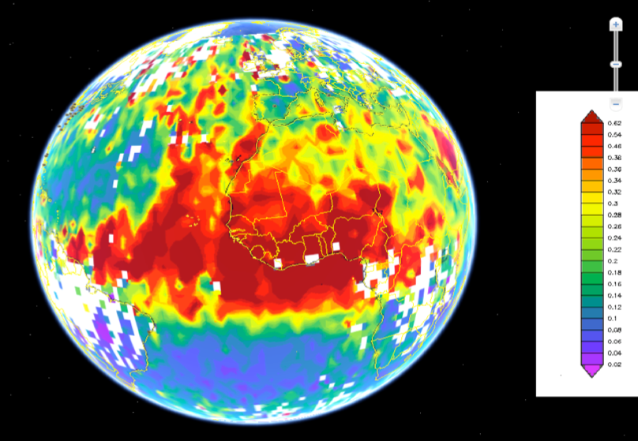
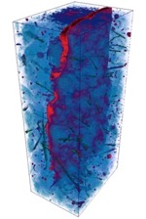
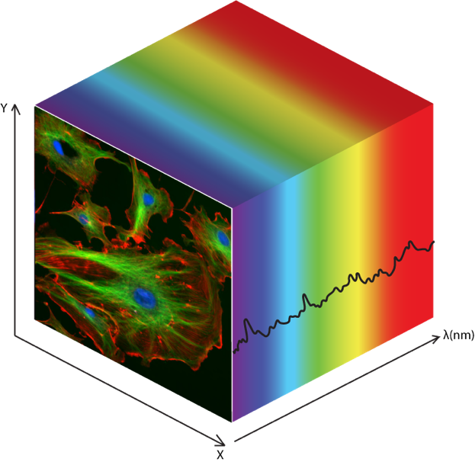
Data Dimensional Structure
Unstructured
1D
2D
3D
ND
Columns aren’t synchronized by rows
Histograms, normalization, bad values
Threshold anomalies
Distribution plotting
Rows imply an order
Model building
Template matching
Structure anomalies
Simple plotting
Peak finding
Rows imply an order
2 Features are related
Complex model building
2D Templates
Distance metrics
Segmentation
Geo grid graphing
Rows imply an order
3 Features are related
Complex model building
3D Templates
Distance metrics
Segmentation
Slicing/Rotation Graph
Rows imply an order
N Features related
Complex model building
ND Templates
Segmentation
Many Dist Metrics
Dimensionality Red.
Repeat Samples
Raw Sensor Output
Time Series
State Changes
Lat/Lon
Camera Images
Parameter Sweeps
Polarization Map
2D movies
Volume Imaging
Metadata-rich data
Hyperspectral
High-D Imaging

Slide 7
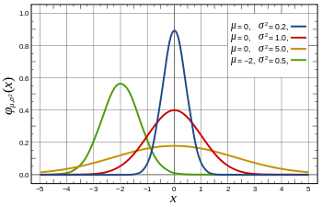
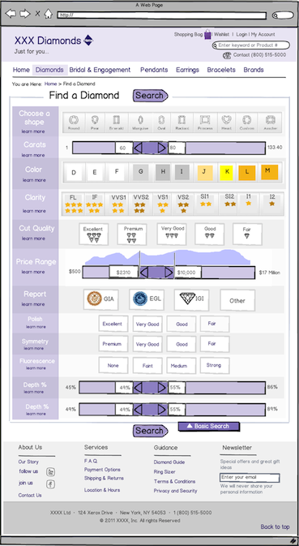
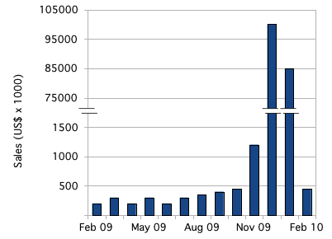
Initial Data Scan: “Is This Right?”
Column Span & Norm.
Setting Pre-Filters
Problem values can be hard to spot
Can be rare or in-range
May harm (but not destroy) analysis
Automation looks for them all
Enables educated pre-filtering of data
Guides user on data size consequences
Filtration tool informed by pop dist.
Group columns by “behavior”
1st simple scan for outliers
Strange Values
Dynamic, Graphical Interface
Estimated file / memory sizes
Guidance on distribution
Discover Inf, Nan, missing values
Discover fill / repeated values

Slide 8
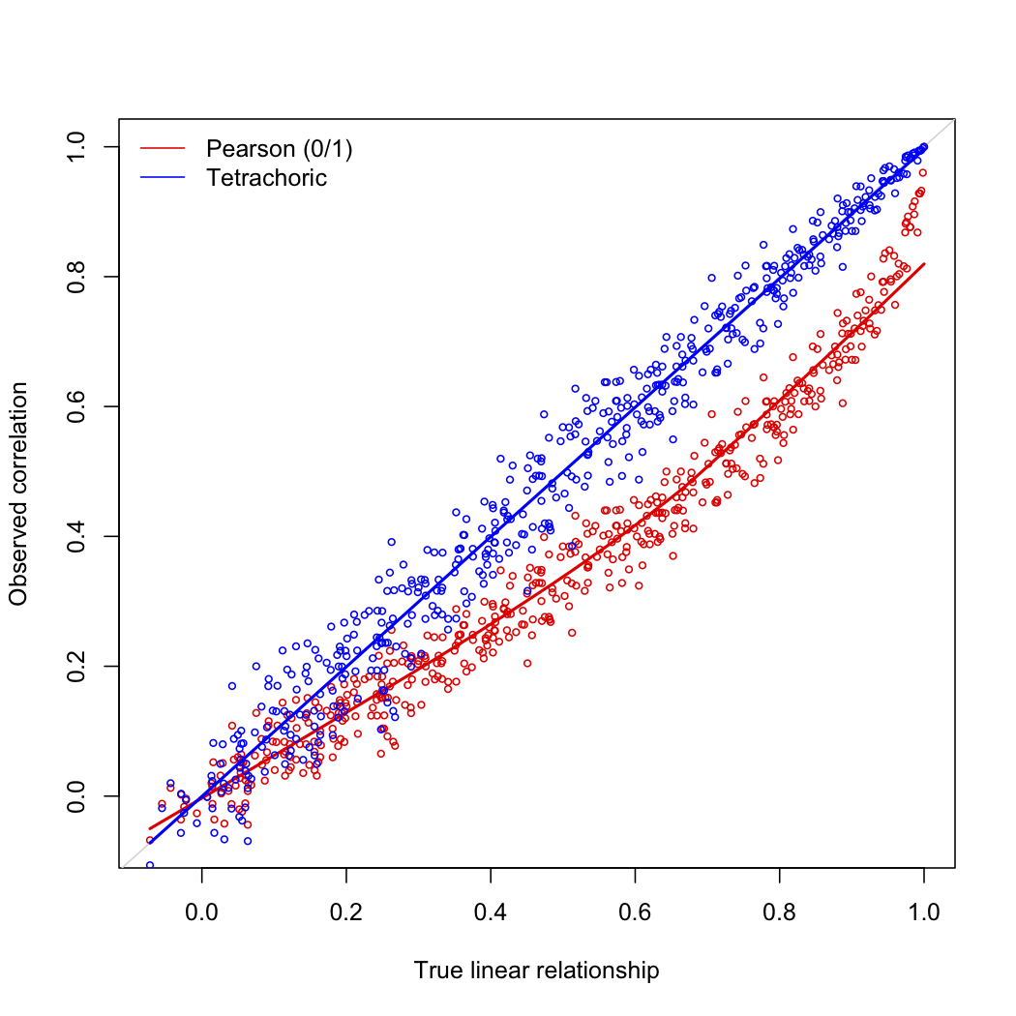
Column Correlation
Correlation Matrix
Alternative Corr.
Using correlated features can ruin analysis
Analysis doesn’t usually fail:
…it just changes your answer unpredictably
Pre-warning on what’s in the data helps
Arrange cols by corr strength
Quickly check what’s safe
Let y2 be f(y1) for simple f
Then find correlations
Speaks to “any relationship”
Results in Spreadsheet form

Slide 9
Data Clustering
How many Populations?
Auto-clean outliers
Fast way to quickly label sub-sets
Works if distance concept exists
Group by column relationship…
... not mere thresholds
Find best # of clusters
Examine separation of clusters
Informative for test/train split
Outliers may be signal/noise
1-click select & keep/remove
Quick “types” of data
Easily select sub-groups
Many clustering algorithms

Slide 10
Dimensionality Reduction
Learn Data Manifold
Aligned Projection
Normal graphs:
2D projection along column
Dim Reduction:
Reveal structure along “best” view
Unfold lower-D manifold
Each method grants diff perspectives
Together very powerful intuition
Find axes aligned with data
Make a ”best” projection
PCA: Data Variance
LDA: Most Label Separation
Many others
Preserves nearest-neighbors
Structure of “whole data” view
Different methods = diff views
Auto-explore parameters
tSNE, others

Slide 11
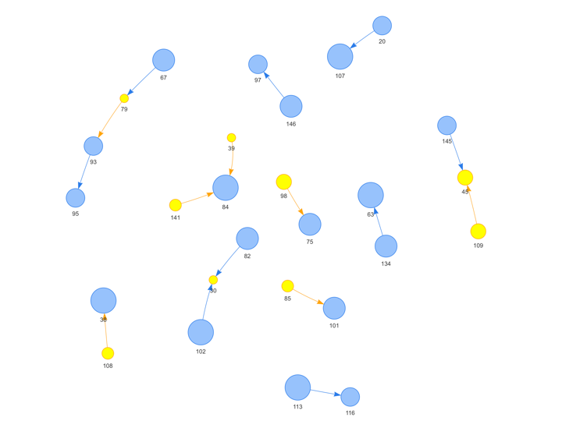
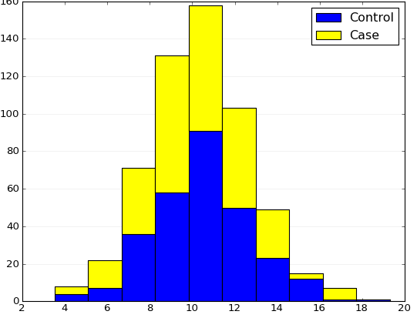
Linking and Brushing
Selected Data in One Graph
Same data in all graphs, treat as such
Highlighting data HERE also applies EVERYWHERE
Huge speed-up of intuition building and outlier exploration
ML: Automated explanation of selected data
Single Button Click Generates
Simple Explanation of Selection
Highlights same data in all other graphs

Slide 12
Anomaly Discovery
Autocorrelation /
Peak Finding (1D)
Endmembers
Look for things that seem different
Anomalies may be treasure or trash
“Pure” basis of data
All other data linear mixture
Can then “unmix” into these basis elements
Treat column by itself
Look for uncommon structure
DEMUD
Model Fitting (ND)
PCA-based
List of “Most Unusual” data elements in order
Often corresponds to scientific interest
Treat many columns together
Beyond threshold detection

Slide 13
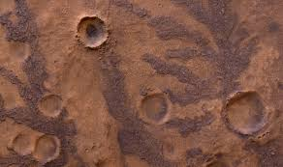
“Things Like This”
Specify Interesting Subset
Automatically scan for other examples
Provides frequency statistics
Makes list for user to examine
Search Time (1D) Series for similar events
Search Images (HyperSpec) for Craters
Above Use Case Maps Out Flat, Smooth regions
Opposite of Anomalies: Things Like This
Can highlight anything WITHOUT EXPLAINING why
Above Use Case Discovers similar craters on Mars
Can use all data columns simultaneously
Quick counts of what “looks like this”

Slide 14
Global Interface Design
Most Data Actions Shall Support:
Predictive run-times to complete
“Watch It Work” shows actual progress
Permit other data actions while busy
Export results with 1 click to file
Honor brushing & linking regions colors/labels
Utilize Multiple Cores for speed
Offer users guidance and advice

Slide 15
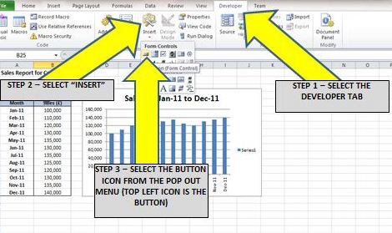
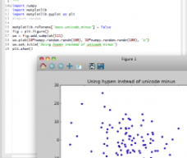
Power User Mode
Precise graphing control via Python & others
Buttonize macros that repeat an exploration
Permit Python extensions to data actions without editing Data Explorer (extensions)

Slide 16
Summary: ML-Powered Tools
Dr. Lukas Mandrake
Speed Data Actions:
Access
Cleaning
Build Intuition:
Structural Understanding
Sub-populations
Enable Better Filtration:
Informed Selection
Friendly Output Formats
Support Later Analysis:
Not trying to be Python / Matlab

Slide 17
Interface Concepts

Slide 18
Datasets Available
/
Apply Cutoff
Cluster
Reduce Dimension
Segment
Bin
Find Endmembers
Find More Like This
Regress
Peak Find
Normalize
Find Anomalies
XY Scatter
Histogram
Sorting
Options
Polar Scatter
Lattitude
Data Actions
Plots
Longitude
Time
Pie
Temp
Pressure
Aerosols
Quality Flag
The interface consists of six parts
Current dataset / columns available
Data Actions performed on columns
Subsets that restrict the rows to use
Plots (advanced) that display rows/col data
Reports that return answers / subsets
(not shown) Right-click context menu
xCO2
Grid
Cloud Index
Earth Map
Columns Available
Multi-
Modality
Available Subsets
Correlation
Col Sets
Reports
General Problems
Define New
Selection
First
Selection
Named Selection
Default3
N/A
N/A
N/A
N/A
N/A
N/A
Explain This Subset
Spatial
Aerosols
Spectral

Slide 19
Column Selection
Can be MANY columns (1000+)
Need to be able to sort them
Wildcard selection
Save “Sets” of Columns for re-use
Column Set Builder Dialog likely needed
Some Actions/Reports generate Col Sets
Color is not important
Double-click examines data in tabular form
Sorting
Options
Lattitude
Longitude
Time
Temp
Pressure
Aerosols
Quality Flag
xCO2
Cloud Index
Columns Available
Row Selection
Millions of Rows
Brushing main method
Data Actions / Reports can generate sets
“Define New” dialog to specify rules
Color is important: matches plotted graphs
Saved Row Sets
Saved
Sets
Define New
Selection
First
Selection
Named Selection
Default3
N/A
N/A
N/A
N/A
N/A
N/A
Spatial
Aerosols
Spectral

Slide 20
Datasets Available
/
Apply Cutoff
Cluster
Reduce Dimension
Segment
Bin
Find Endmembers
Find More Like This
Regress
Peak Find
Normalize
Find Anomalies
Data Actions
Data Actions
Bring Up a Dialog
Need User Guidance
Work on (row subset) and (column set)
Have parameters for control
Output NEW COLUMNS (id’s, coordinates, labels, float values, masks)
Main CODEX uniqueness – the “Heart” of CODEX

Slide 21

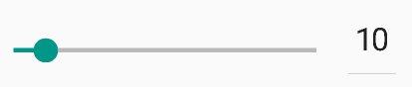

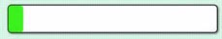
Datasets Available
/
Apply Cutoff
Group Data
by Clusters
Reduce Dimension
Segment
Bin
Find Endmembers
Find More Like This
Regress
Peak Find
Normalize
Find Anomalies
Guidance help everywhere
About any question asked
Clustering (Grouping Nearby Data)
Method
Distance Metric:
Number of Clusters:
ETA:
20 mins
Mem:
100 MB
Action Dialog
Sensible defaults
Guides User via ? Buttons and graphical aids
Minimum Jargon / Still Precise
Feeds in from the Column selector to left
Feeds in from subset selection below
When guidance predictions look bad, recommend user actions to help like sub-setting columns or rows, different method, reducing dimensionality, or param settings

Slide 22
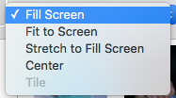
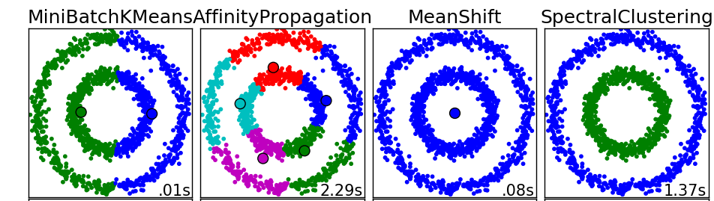
Datasets Available
/
Apply Cutoff
Group Data
by Clusters
Reduce Dimension
Segment
Bin
Find Endmembers
Find More Like This
Regress
Peak Find
Normalize
Find Anomalies
System Recommendation
Cluster Method Selection
Recommendation
K-Means:
-Fast
-Standard
-Robust
Clustering (Grouping Nearby Data)
Method
Distance Metric:
Number of Clusters:
Parameter Selection Dialog
Always offer graphical selection from examples
Discrete list choices are easy here
Floating Point sliders are more challenging (dynamic range)
Permits user to see a hint of results before selection
Offer text guidance as well under ? button
Graphical Guidance for Param Choice
Enabled by intelligent subsampling and guessing which columns are useful to plot against

Slide 23
XY Scatter
Histogram
Polar Scatter
Plots
Pie
Plots are the main tool of exploration
Persistent & Dynamic
Reflect “Progress” of understanding
Many are made, some are retained
Main interface for row sets (brushing) – first class set add/subtract
Zoomable, axes limit setting
Many options for each 3 basic types
The “Face” of CODEX
Heat Map
Lat / Lon

Slide 24
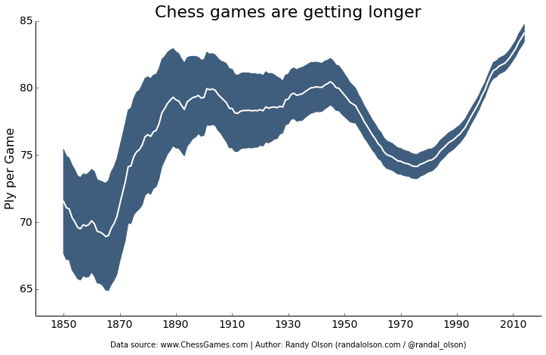
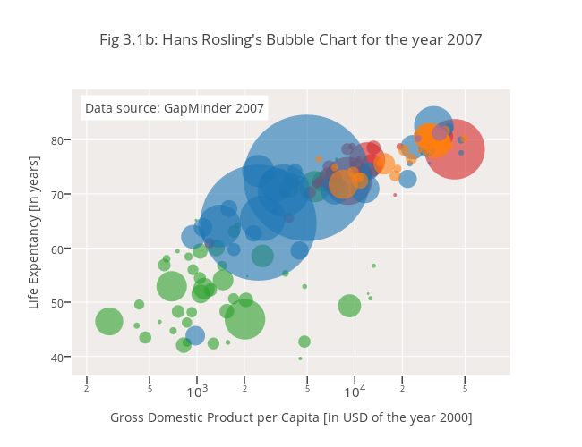
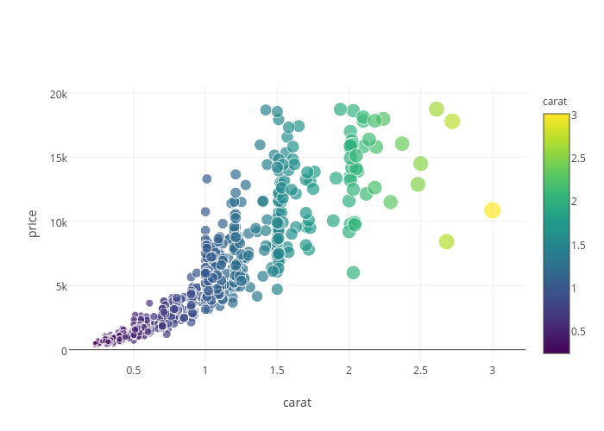
XY Scatter
Histogram
Polar Scatter
Pie
Heat Map
Lat / Lon
XY Scatterplot Workhorse (ROBUST)
Excel-model graph generation
Clicking Button initiates new graph
Right-click to change row/column set to use
Set by columns for color, size, transparency, error bars, envelope
Marginal Histograms on X & Y (assume many rows)
Colorbar, color palette selection (intelligent options)
Datapoint values/labels display per point
Opacity for over-plotting issues
Can color uniformly, by a column value + palette, or by subset
Subtlety: Could plot a subset (ignore outside subset), or could color BY the subset

Slide 25
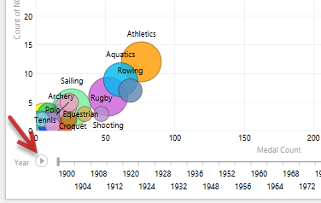
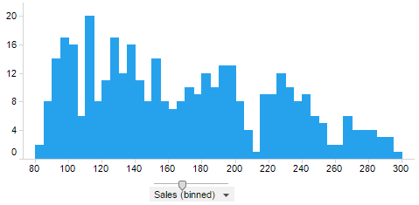
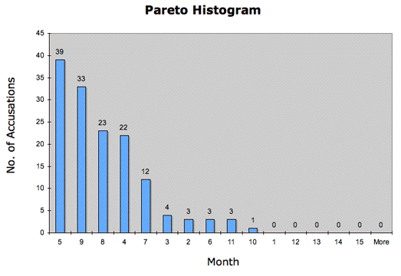
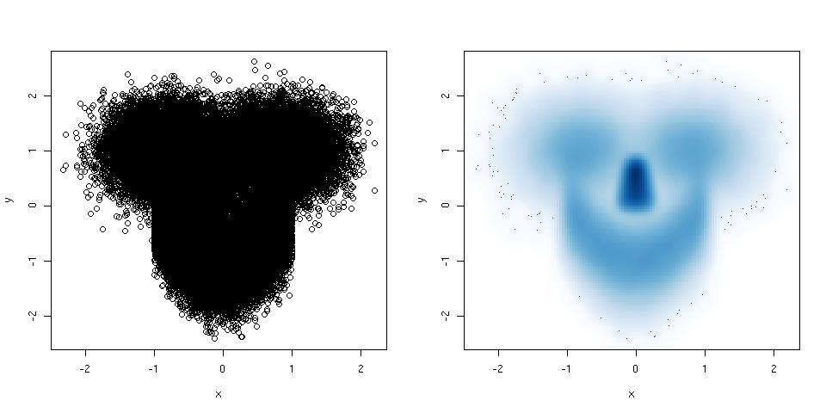
Special Graph Interactivity
Attach slider bar to “scan over” column window
Point selection highlights everywhere and shows value
”Sort by” axis option, sort X by Y or vvs, useful for histograms
Guidance: detect over-plotting, recommend heat map
XY Scatter
Histogram
Polar Scatter
Pie
Heat Map
Lat / Lon
Scatter plot
Heat Map

Slide 26
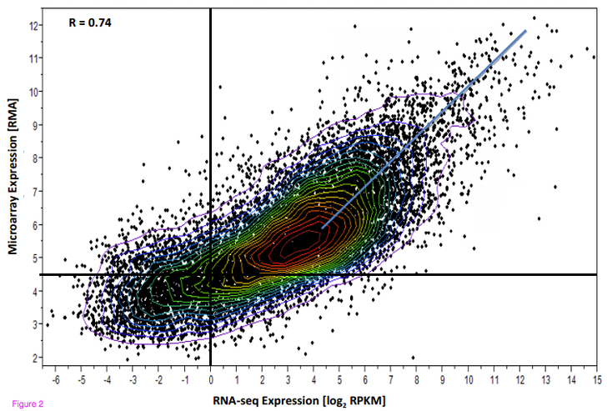
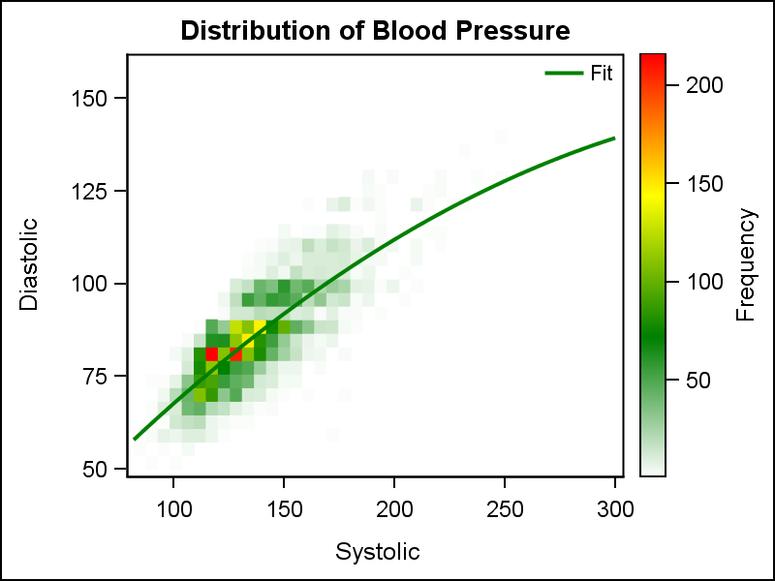
Scatter + Contoured Heat Map
XY Scatter
Regression Scatter + Heat Map
Histogram
Polar Scatter
Pie
Heat Map
Lat / Lon
Scatter (colored by group ID) + Scatter (Cluster Centers)
Combining Graphs
For graphs with compatible axis, can pull together or apart
Set order of graph layers
Heat Map + XY Scatter most common
“Compare this graph” by having it fade between layers
Advanced Legends

Slide 27
Reports Answer Questions Directly
Scan for properties of data that may snag analysis
Can generate column or row subsets
Always generate text reports
Can generate tabular output
Multi-
Modality
Correlation
Reports
Bad Values
Explain This Subset

Slide 28
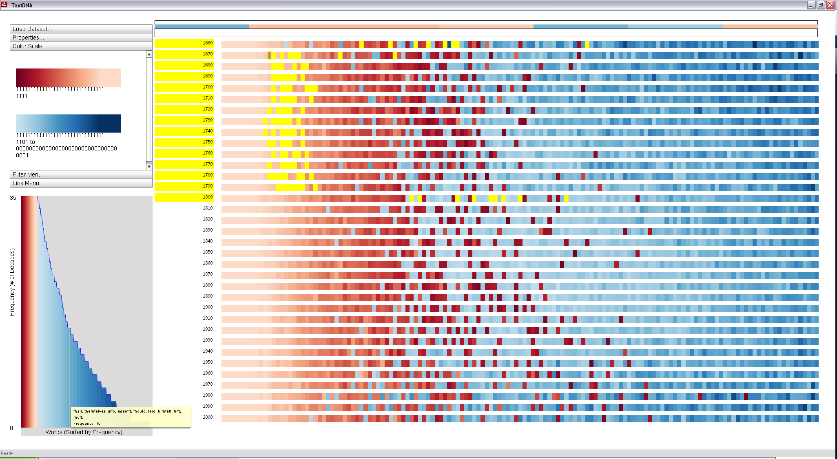
Bad Value Scan
Checks the “common problems” everyone should know
All findings clickable to see columns & rows where occur
Generates multiple col & row subsets
Can dynamically explore with slider thresh
Bad Value Scan
Of 6.1e4 rows & 45 cols,
Inf : 7890 = 0.01%
NaN: 204 = 0.00%
Min Freq
Frequent Values report:
Column | Value | Frequency
Quality Flag | 1 | 99.2%
Latitude | 0.0 | 65%
xCO2 | -1.0 | 25%
Samples ->
Min Sigma
Multi-
Modality
Outlier Report
Correlation
Column | N Sigma | Num
xCO2 | > 8 | 14
Aerosols | < -12 | 107
Columns->
Bad Values
Explain This Subset

Slide 29
Datasets Available
/
Apply Cutoff
Cluster
Reduce Dimension
Segment
Bin
Find Endmembers
Find More Like This
Regress
Peak Find
Normalize
Find Anomalies
XY Scatter
Histogram
Sorting
Options
Polar Scatter
Lattitude
Longitude
Time
Pie
Temp
Pressure
Aerosols
Quality Flag
xCO2
Grid
Cloud Index
Earth Map
Multi-
Modality
Common Working Mode
Many overlapped graphs
Desktop-analogy
Correlation
General Problems
Define New
Selection
First
Selection
Named Selection
Default3
N/A
N/A
N/A
N/A
N/A
N/A
Explain This Subset
Spatial
Aerosols
Spectral

Slide 30
Segment
Segment Data
Discovers regions of similarity in data based on an axis (e.g. time, index, distance). Useful for finding when/where the data changes character. Outputs a column of segment ID’s.
Sorting
Options
Lattitude
Column: Lattitude
Float64
6.1M rows
Min: -87.1
Max: 55.2
Mean: 25.0
Median: 24.2
Mode: 26.0
NaN/Inf: 12
View Tabular
Save as file
Normalize
Find Correlates
Delete
Longitude
Time
XY Scatter Plot
Axes
Row/Columns
Line Properties
Marker properties
Save as image
Save shown data
Save code
Layers
Marginals
Sliders
Colorbar
Format
Legend
Delete
Duplicate
“Hidden” Sixth interaction – The Right Click Context Menu!
Everything should be helpful when right-clicked
Plots reveal dialog for all plot options
Columns offer column-based plots, tabular access, value range information, etc.
Row Set: First Selection
4.5e6 / 6.1e6 = 85%
Origin: plot Lat vs Lon
In Use: No
View Tabular
Save as file
Save as mask
Explain vs. other subset
Delete
Duplicate
Modify / Manage
First
Selection

Slide 31
A Detailed Use Case for Dev Guidance

Slide 32
OCO-2 Exploration Finding the Problem Soundings
Datasets Available
/
Apply Cutoff
Cluster
Reduce Dimension
Segment
Bin
Find Endmembers
Find More Like This
Regress
Peak Find
Normalize
Find Anomalies
XY Scatter
Histogram
Sorting
Options
Polar Scatter
Lattitude
Longitude
Time
Load in data file: OCO2 XXXXXXXX
Pie
Temp
Pressure
Aerosols
Quality Flag
xCO2
Grid
Cloud Index
Earth Map
Let’s load the data and ensure the features I expect appear in the feature list
Multi-
Modality
Correlation
General Problems
Define New
Selection
First
Selection
Explain This Subset
Spatial
Aerosols
Spectral

Slide 33
Datasets Available
/
Apply Cutoff
Cluster
Reduce Dimension
Segment
Bin
Find Endmembers
Find More Like This
Regress
Peak Find
Normalize
Find Anomalies
XY Scatter
General Problem Scan
Of 6.1e4 rows & 45 cols,
Inf : 7890 = 0.01%
NaN: 204 = 0.00%
Histogram
Sorting
Options
Polar Scatter
Lattitude
Longitude
Time
Checking for weird soundings
I know there always are many.
Pie
Temp
Pressure
Aerosols
Quality Flag
Min Freq
xCO2
Grid
Cloud Index
Frequent Values report:
Column | Value | Frequency
Quality Flag | 1 | 99.2%
Latitude | 0.0 | 65%
xCO2 | -1.0 | 25%
Earth Map
Min Sigma
Multi-
Modality
Outlier Report
Perform General Problem Scan
Correlation
Column | N Sigma | Num
xCO2 | > 8 | 14
Aerosols | < -12 | 107
General Problems
Define New
Selection
Explain This Subset
Spatial
Aerosols
Spectral

Slide 34
Datasets Available
/
Apply Cutoff
Cluster
Reduce Dimension
Segment
Bin
Find Endmembers
Find More Like This
Regress
Peak Find
Normalize
Find Anomalies
XY Scatter
Looks like a bunch of nonsense xCO2 values occur. I wonder where that happens in space and time…
Make row subsets for bad xCO2 values and bad Quality Flags and very high aerosol values
General Problem Scan
Of 6.1e4 rows & 45 cols,
Inf : 7890 = 0.01%
NaN: 204 = 0.00%
Histogram
Sorting
Options
Polar Scatter
Lattitude
Columns (sorted by problems)->
Longitude
Time
Pie
Temp
Pressure
Aerosols
Quality Flag
Min Freq
xCO2
Grid
Cloud Index
Frequent Values report:
Column | Value | Frequency
Quality Flag | 1 | 99.2%
Latitude | 0.0 | 65%
xCO2 | -1.0 | 25%
Earth Map
Rows ->
Min Sigma
Multi-
Modality
Outlier Report
Perform General Problem Scan
Correlation
Column | N Sigma | Num
xCO2 | > 8 | 14
Aerosols | < -12 | 107
General Problems
Define New
Selection
xCO2 Frequent Value = -1.0
Quality Flag = 0
Aerosols > 1.0
Explain This Subset
Spatial
Aerosols
Spectral

Slide 35
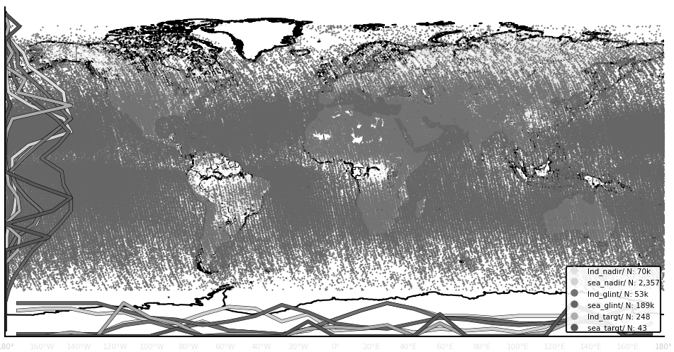
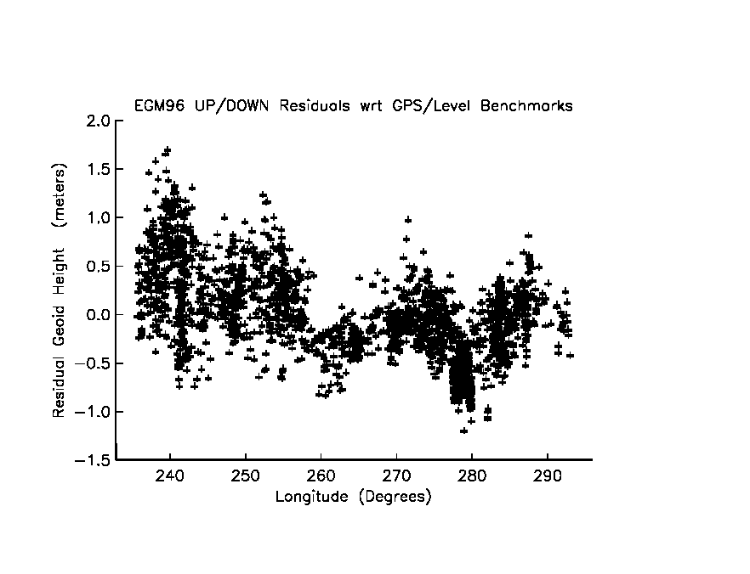
Datasets Available
/
Apply Cutoff
Cluster
Reduce Dimension
Segment
Bin
Find Endmembers
Find More Like This
Regress
Peak Find
Normalize
Find Anomalies
XY Scatter
Histogram
Time vs. Lat just uses X/Y
Make a plot of Lat vs. Lon
Make another plot of Time vs. Lat
Color subselections by row subset masks to build intuition
Sorting
Options
Polar Scatter
Lattitude
Longitude
Time
Pie
Temp
Pressure
Aerosols
Latitude
Quality Flag
xCO2
Grid
Cloud Index
Lat / Lon best on Earth map
Earth Map
Optional marginals
Longitude
Latitude
Multi-
Modality
Correlation
Time
General Problems
Define New
Selection
xCO2 Frequent Value = -1.0
Quality Flag = 0
Aerosols > 1.0
Explain This Subset
Spatial
Aerosols
Spectral

Slide 36
Datasets Available
/
Apply Cutoff
Cluster
Reduce Dimension
Segment
Bin
Find Endmembers
Find More Like This
Regress
Peak Find
Normalize
Find Anomalies
XY Scatter
Histogram
Sorting
Options
Polar Scatter
Lattitude
Longitude
Time
Pie
Temp
Pressure
Aerosols
Latitude
Quality Flag
xCO2
Grid
Cloud Index
Earth Map
Immediately shows selection here
Longitude
I wonder where that group of outliers is on the top map?
Hmmm. Clustered in space and time. Let’s keep that selection for later.
Latitude
User paints selection
Multi-
Modality
Correlation
Time
General Problems
Define New
Selection
xCO2 Frequent Value = -1.0
Quality Flag = 0
Aerosols > 1.0
User Selection 1
Explain This Subset
Spatial
Aerosols
Spectral

Slide 37
Datasets Available
/
Apply Cutoff
Cluster
Reduce Dimension
Segment
Bin
Find Endmembers
Find More Like This
Regress
Peak Find
Normalize
Find Anomalies
XY Scatter
Histogram
Sorting
Options
Polar Scatter
Lattitude
Longitude
Time
Pie
Temp
Pressure
Aerosols
Latitude
Quality Flag
xCO2
I see blue looks like mountains, know problem. OK to filter out.
Red clearly relates to extreme high latitudes, but why?
Green continues to be a mystery, as does yellow…
Grid
Cloud Index
Earth Map
Longitude
Latitude
Multi-
Modality
Correlation
Time
General Problems
Define New
Selection
xCO2 Frequent Value = -1.0
Quality Flag = 0
Aerosols > 1.0
User Selection 1
Explain This Subset
Spatial
Aerosols
Spectral

Slide 38
Datasets Available
/
Apply Cutoff
Cluster
Reduce Dimension
Segment
Bin
Find Endmembers
Find More Like This
Regress
Peak Find
Normalize
Find Anomalies
XY Scatter
Histogram
Sorting
Options
Polar Scatter
Lattitude
Longitude
Let’s use “Explain vs. Others” right-click dialog on the two row subsets to clarify…
First red (xCO2 Frequent Value = -1.0) vs. “All else”
Make it use all features EXCEPT Lat, Lon, Time, and xCO2 (we already know how it behaves with these)
Time
Pie
Temp
Pressure
Aerosols
Latitude
Quality Flag
xCO2
Grid
Cloud Index
Earth Map
Longitude
Row Set: xCO2 Frequent Value = -1.0
1.2e6 / 6.1e6 = 23%
Origin: General Problem Scan
In Use: Yes
View Tabular
Save as file
Save as mask
Explain vs. other subset
Delete
Duplicate
Modify / Manage
Latitude
Multi-
Modality
Correlation
Time
General Problems
Define New
Selection
xCO2 Frequent Value = -1.0
Quality Flag = 0
Aerosols > 1.0
User Selection 1
Explain This Subset
Spatial
Aerosols
Spectral

Slide 39

Datasets Available
/
Apply Cutoff
Cluster
Reduce Dimension
Segment
Bin
Find Endmembers
Find More Like This
Regress
Peak Find
Normalize
Find Anomalies
XY Scatter
Histogram
Sorting
Options
Explanation of
xCO2 Frequent Value = -1.0
vs. (everything else)
[progress bar / runtime complete]
Explains 86% variance
Informative columns = 4
Polar Scatter
Lattitude
Aha! Red happens because Solar Azimuth has really high values… or if there’s ice on the ground. Known issues. OK to filter out.
(continue for others… but methods returns “no suitable explanation found (>65% explanatory power)” They will not be filtered out.
Longitude
Time
Pie
Temp
Pressure
Aerosols
Latitude
Quality Flag
xCO2
Grid
Cloud Index
Earth Map
Informative Features = 4 | PVE
Solar Azimuth (> 70, <-70) | 80%
Blended_albedo (> 0.8) | 10%
Aerosols (> 0.8) | 2%
dP (< -5.0) | 1.5%
Longitude
Latitude
Multi-
Modality
Correlation
Time
General Problems
Define New
Selection
xCO2 Frequent Value = -1.0
Quality Flag = 0
Aerosols > 1.0
User Selection 1
Explain This Subset
Spatial
Aerosols
Spectral

Slide 40
Datasets Available
/
Apply Cutoff
Cluster
Reduce Dimension
Segment
Bin
Find Endmembers
Find More Like This
Regress
Peak Find
Normalize
Find Anomalies
XY Scatter
Histogram
Sorting
Options
Polar Scatter
Lattitude
Make a new row subset of red AND blue, but don’t use green or yellow.
Then right-click on that new subset and “save this subset of the original file” to effectively filter out the known issues.
Longitude
Time
Pie
Temp
Pressure
Aerosols
Latitude
Quality Flag
xCO2
Grid
Cloud Index
Earth Map
Longitude
Latitude
Multi-
Modality
Correlation
Time
General Problems
Define New
Selection
xCO2 Frequent Value = -1.0
Quality Flag = 0
Aerosols > 1.0
User Selection 1
Explain This Subset
Spatial
Aerosols
Spectral

Slide 41
Seek Clusters in Data
Datasets Available
/
Apply Cutoff
Cluster
Reduce Dimension
Segment
Bin
Find Endmembers
Find More Like This
Regress
Peak Find
Normalize
Find Anomalies
XY Scatter
Histogram
Sorting
Options
Polar Scatter
Lattitude
Longitude
Time
Load in data file: Workplace Survey XXXXXXXX
Pie
Temp
Pressure
Aerosols
Quality Flag
xCO2
Grid
Cloud Index
Earth Map
Let’s load the data and ensure the features I expect appear in the feature list
Multi-
Modality
Correlation
General Problems
Define New
Selection
First
Selection
Explain This Subset
-
-
-

Slide 42
Datasets Available
/
Apply Cutoff
Cluster
Reduce Dimension
Segment
Bin
Find Endmembers
Find More Like This
Regress
Peak Find
Normalize
Find Anomalies
XY Scatter
General Problem Scan
Of 138 rows & 300 cols,
Inf : 0 = 0.0%
NaN: 425 = 12%
Histogram
Sorting
Options
Polar Scatter
Lattitude
Columns (sorted by problems)->
Longitude
Time
Weird data shows no surprises. It’s survey data, so frequent values are meaningless, as are outliers.
But what’s with the Nans? Oh no… missing data!
Pie
Temp
Pressure
Aerosols
Quality Flag
Min Freq
xCO2
Grid
Cloud Index
Frequent Values report:
Column | Value | Frequency
Quality Flag | 1 | 99.2%
Latitude | 0.0 | 65%
xCO2 | -1.0 | 25%
Earth Map
Rows ->
Min Sigma
Multi-
Modality
Outlier Report
Perform General Problem Scan
Correlation
Column | N Sigma | Num
xCO2 | > 8 | 14
Aerosols | < -12 | 107
General Problems
Define New
Selection
Explain This Subset
-
-
-

Slide 43
Datasets Available
/
Apply Cutoff
Cluster
Reduce Dimension
Segment
Bin
Find Endmembers
Find More Like This
Regress
Peak Find
Normalize
Find Anomalies
XY Scatter
Histogram
Sorting
Options
Work with the NaN visualizer to see which columns / rows are affected.
Easily sort the Columns by # of NaN’s present
Discover that only 40 columns don’t have NaN’s. Form a COLUMN SUBSET of NaN-less data
Polar Scatter
Lattitude
Columns (sorted by problems)->
Longitude
Time
Pie
Temp
Pressure
Aerosols
Quality Flag
xCO2
Grid
Cloud Index
Earth Map
Rows ->
Multi-
Modality
Correlation
General Problems
Define New
Selection
Form Column Subset of Complete Data
Explain This Subset
Non-NaN
-
-

Slide 44
Datasets Available
/
Apply Cutoff
Cluster
Reduce Dimension
Segment
Bin
Find Endmembers
Find More Like This
Regress
Peak Find
Normalize
Find Anomalies
XY Scatter
Cluster Method Selection
Histogram
Sorting
Options
Recommendation
K-Means:
-Fast
-Standard
-Robust
Polar Scatter
Lattitude
Longitude
Clustering (Grouping Nearby Data)
Time
Pie
Temp
Method
Pressure
Aerosols
Quality Flag
xCO2
Distance Metric:
Grid
Cloud Index
Explore Clustering using non-NaN column subset minus a few other columns the user didn’t want included.
Quick-guidance thumbnails helped inform decisions of general seperability vs. methods
Number of Clusters:
Earth Map
Multi-
Modality
Correlation
General Problems
Define New
Selection
Explain This Subset
Non-NaN
-
-

Slide 45
Datasets Available
/
Apply Cutoff
Cluster
Reduce Dimension
Segment
Bin
Find Endmembers
Find More Like This
Regress
Peak Find
Normalize
Find Anomalies
XY Scatter
Histogram
Sorting
Options
User chooses to cluster with 2 and 4 clusters, to compare the difference, making new columns.
Need plotting axis, so user performs PCA and ICA dimensional reduction and takes the first two components of each as new columns again.
Polar Scatter
Lattitude
Longitude
Time
Pie
Temp
Pressure
Aerosols
Quality Flag
xCO2
Grid
Cloud Index
Cluster ID 1
Cluster ID 2
PCA 1
Earth Map
PCA 2
ICA 1
ICA 2
Multi-
Modality
Correlation
General Problems
Define New
Selection
Explain This Subset
Non-NaN
-
-

Slide 46
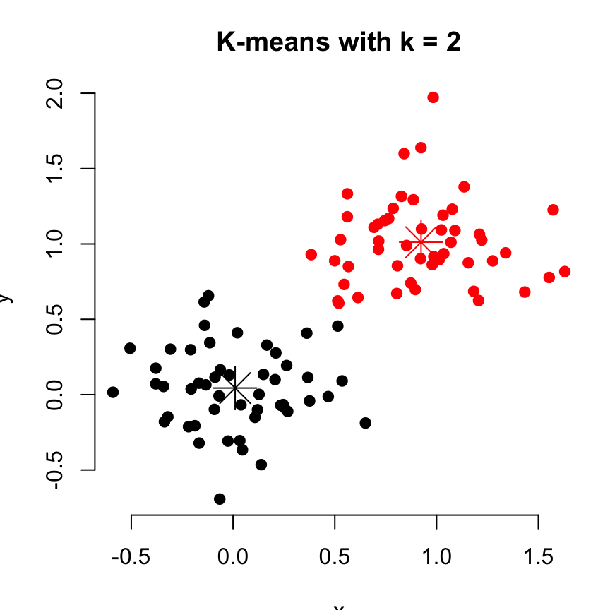
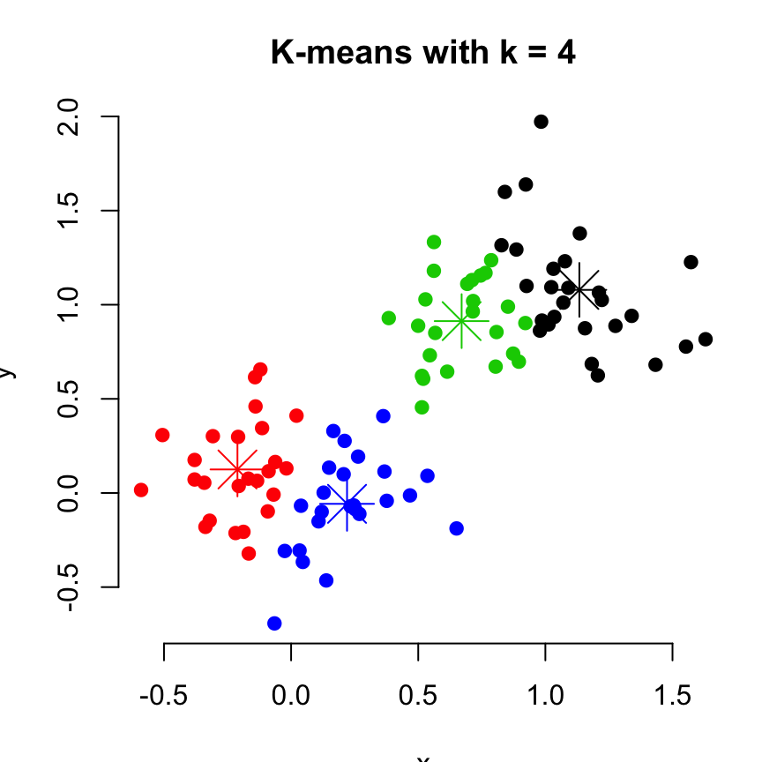
Datasets Available
/
Apply Cutoff
Cluster
Reduce Dimension
Segment
Bin
Find Endmembers
Find More Like This
Regress
Peak Find
Normalize
Find Anomalies
XY Scatter
Histogram
Sorting
Options
User plots k=2 & k=4 cluster results using PCA coords and ICA coords separately and puts graphs in a grid to study them.
Plots are colored by cluster ID.
But it’s really hard to see differences between them, so selects the graphs and right-clicks “Compare these Graphs.”
Polar Scatter
Lattitude
Longitude
Time
Pie
Temp
Pressure
Aerosols
Quality Flag
xCO2
Grid
Cloud Index
Cluster ID 1
Cluster ID 2
PCA 1
Earth Map
PCA 2
ICA 1
ICA 2
Multi-
Modality
Correlation
General Problems
Define New
Selection
Explain This Subset
Non-NaN
-
-

Slide 47
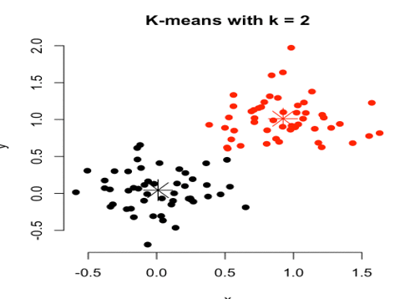
Datasets Available
/
Apply Cutoff
Cluster
Reduce Dimension
Segment
Bin
Find Endmembers
Find More Like This
Regress
Peak Find
Normalize
Find Anomalies
XY Scatter
Histogram
Sorting
Options
Cross-fading graphs clearly show the cluster breaks and differences, allowing the user to judge the results.
Cluster=2 is selected for further analysis. A ROW SUBSET is generated by clicking on “Define New Selection” and entering “Cluster ID 1 == 2”.
Code to reproduce this selection is then saved via right-click-“Interesting Cluster” row subset.
Polar Scatter
Lattitude
Longitude
Time
Pie
Temp
Pressure
Aerosols
Quality Flag
xCO2
Grid
Cloud Index
Cluster ID 1
Cluster ID 2
PCA 1
Earth Map
PCA 2
ICA 1
ICA 2
Multi-
Modality
Correlation
General Problems
Define New
Selection
Interesting Cluster
Explain This Subset
Non-NaN
-
-

Slide 48
Datasets Available
/
Apply Cutoff
Cluster
Reduce Dimension
Segment
Bin
Find Endmembers
Find More Like This
Regress
Peak Find
Normalize
Find Anomalies
XY Scatter
User decides wants to keep Cluster ID’s, PCA, and ICA outputs for further analysis. Saves the original file with these columns appended.
Histogram
Sorting
Options
Polar Scatter
Lattitude
Longitude
Time
Pie
Temp
Pressure
Aerosols
Quality Flag
xCO2
Grid
Cloud Index
Cluster ID 1
Cluster ID 2
PCA 1
Earth Map
PCA 2
ICA 1
ICA 2
Multi-
Modality
Correlation
General Problems
Define New
Selection
Interesting Cluster
Explain This Subset
Non-NaN
-
-

